Slide 1

WEB TECHNOLOGIES – LECTURE 19
UNIVERSITÀ DEGLI STUDI DI NAPOLI FEDERICO II
FRONTEND FRAMEWORKS: ANGULAR
Luigi Libero Lucio Starace, PhD
luigiliberolucio.starace@unina.it https://luistar.github.io https://www.docenti.unina.it/luigiliberolucio.starace

Slide 2
PREVIOUSLY, ON WEB TECHNOLOGIES
We’ve learned about Single Page Applications
A single web page, with (a good deal of) client-side JavaScript code, that switches between different views by updating the DOM, without fully loading different pages
Some complexity involved:
Client-side routing
View rendering
Components and Code Re-use
Front-end Frameworks are a pre-defined set of software components, tools, and best practices that serve as a foundation for developing Single Page Applications

Slide 3

ANGULAR
One of the most widely-used frontend frameworks
Especially in Italy, and for enterprise applications
Developed by Google
Version 2.0 released in 2016
We’ll use version 17

Slide 4
ANGULAR: CHARACTERISTICS
Strong focus on developer tooling and productivity
Batteries included
Angular is an opinionated full-fledged framework (e.g.: includes dependency injection mechanisms, routing, …). This helps reduce decision fatigue and ensures consistency across projects
Migration support
Dedicated tooling to assist developers in migrating to newer versions
Best practices from the start
Enforces TypeScript!

Slide 5
ANGULAR: INSTALLING THE CLI
@luigi ➜ D/O/T/W/2/e/20-Angular $ npm install -g @angular/cli
added 227 packages in 20s
@luigi ➜ D/O/T/W/2/e/20-Angular $ ng version
_ _
/ \ _ _ _ _| | _ _
_
/ | | |_ _|
| |
/ △ \ | '_ \ / _` | | | | |/ _` | ' |
/ \| | | | (_| | |_| | | (_| | |
| | | |
| | | | | |
\ | | |
/_/ \_\_| |_|\ , |\ ,_|_|\ ,_|_|
| /
Angular CLI: 17.0.8
Node: 20.9.0
Package Manager: npm 10.2.2 OS: win32 x64

Slide 6
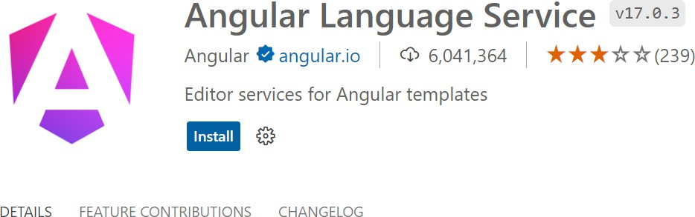
ANGULAR: DEVELOPMENT ENVIRONMENT
We’ll use Visual Studio Code
An optional, but recommended step to improve developer experience is to install the Angular Language Service extension

Slide 7
ANGULAR: CREATING A NEW PROJECT
@luigi ➜ D/O/T/W/2/e/20-Angular $ ng new angular-app --create-application
? Which stylesheet format would you like to use? SCSS
? Do you want to enable SSR and SSG/Prerendering? No CREATE angular-app/angular.json (2791 bytes)
CREATE angular-app/package.json (1042 bytes)
CREATE angular-app/README.md (1064 bytes)
...
CREATE angular-app/src/index.html (296 bytes) CREATE angular-app/src/styles.scss (80 bytes)
CREATE angular-app/src/app/app.component.html (20884 bytes) CREATE angular-app/src/app/app.component.spec.ts (931 bytes) CREATE angular-app/src/app/app.component.ts (370 bytes) CREATE angular-app/src/app/app.component.scss (0 bytes) CREATE angular-app/src/app/app.config.ts (227 bytes)
CREATE angular-app/src/app/app.routes.ts (77 bytes)

Slide 8
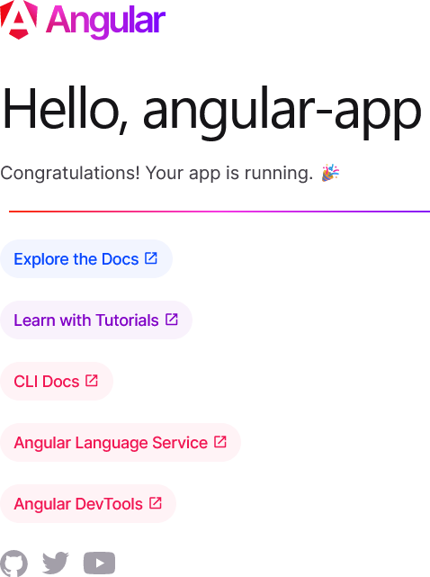
ANGULAR: RUNNING THE PROJECT
@luigi ➜ D/O/T/W/2/e/20-Angular $ cd angular-app
@luigi ➜ D/O/T/W/2/e/2/angular-app $ ng serve
Initial Chunk | Files | | | Names | | | Raw Size
polyfills.js |  | | | polyfills | | | 82.71 kB | |
main.js |  | | | main | | | 23.23 kB | |
styles.css |  | | | styles | | | 96 bytes | |
| Initial Total | 106.03 kB
Application bundle generation complete. [1.176 seconds]
Watch mode enabled. Watching for file changes...
Local: http://localhost:4200/

Slide 9
COMPONENTS
Components are the building blocks of Angular apps
Each component is responsible for defining the function and appearance of an element
Its code (state, business logic, events),
HTML layout,
CSS style
In Angular, a component may also contain other components
You can think of an Angular app as a tree of components
To-do List Page
Add new To-do Form
To-do List
To-do Item

Slide 10
ANATOMY OF A COMPONENT
A component is basically a TypeScript class
Components are annotated with metadata passed as an object to the @Component decorator
Metadata specify, among other things, the HTML layout and CSS (or Sass) styles for the component
@Component({
selector: 'app-root',
standalone: true,
template: "<h1>Hello Angular!</h1>",
styles: "h1 {font-family: sans-serif; color: darkblue;}",
})
export class AppComponent {}

Slide 11
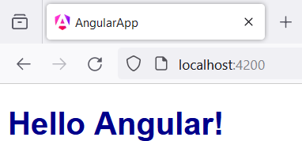
ANATOMY OF A COMPONENT: SELECTOR
selector is used to tell Angular where to render the component
Angular will create an instance of the component for every matching HTML element
Below, the AppComponent will render in <app-root> HTML elems
<!doctype html>
<html lang="en">
<head>
<meta charset="utf-8">
<title>AngularApp</title>
</head>
<body>
<app-root></app-root>
</body>
</html>
import {Component} from'@angular/core';
@Component({
selector: 'app-root', standalone: true,
template: "<h1>Hello Angular!</h1>",
styles: "* {color: darkblue;}",
})
export class AppComponent {}

Slide 12
ANATOMY OF A COMPONENT: TEMPLATES
Templates and styles can also be specified in a separated file
Paths are relative to the position of the TypeScript class
import {Component} from'@angular/core';
@Component({
selector: 'app-root',
standalone: true,
templateUrl: './app.component.html', styleUrl: './app.component.scss'
})
export class AppComponent {}
// app.component.html file
<h1>Hello Angular!</h1>
// app.component.scss file
h1 {
font-family: sans-serif; color: darkblue;
}

Slide 13

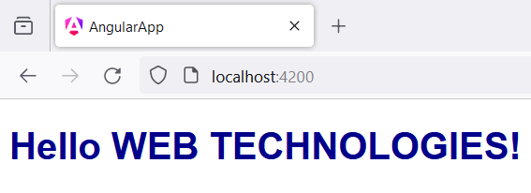
COMPONENTS: INTRODUCING STATE
import { Component } from '@angular/core'; @Component({ selector: 'app-root', standalone: true, template: "<h1>Hello {{name.toUpperCase()}}!</h1>", styles: "h1 {font-family: sans-serif; color: darkblue;}", }) export class AppComponent { name = 'Web Technologies';
}
Expressions within {{ }} in Angular templates are evaluated, and the result (converted as a string) is rendered in the template

Slide 14
COMPOSING COMPONENTS
We created our first component, with its template and styles
What if we want to add a new component to our app?
Suppose we want to add a Counter component, that includes a button and keeps track of how many time the button was clicked on.
We can use the Angular CLI to create the boilerplate code for us
@luigi ➜ D/O/T/W/2/e/2/angular-app $ ng generate component counter
CREATE src/app/counter/counter.component.html (22 bytes) // HTML template
CREATE src/app/counter/counter.component.spec.ts (603 bytes) // tests (will see later)
CREATE src/app/counter/counter.component.ts (239 bytes) // TS class
CREATE src/app/counter/counter.component.scss (0 bytes) // Styles file

Slide 15
GENERATED BOILERPLATE CODE
import { Component } from '@angular/core';
@Component({
selector: 'app-counter', standalone: true, imports: [],
templateUrl: './counter.component.html',
styleUrl: './counter.component.scss'
})
export class CounterComponent {}
// counter.component.html file
<p>counter works!</p>
// counter.component.scss file
// This file is empty

Slide 16
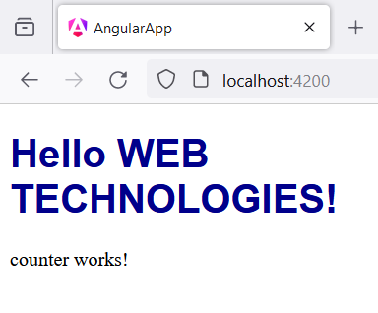

COMPOSING COMPONENTS
import { Component } from '@angular/core’; import { CounterComponent } from './counter/counter.component'; @Component({
selector: 'app-root', standalone: true, imports: [CounterComponent], template: ` <h1>Hello {{name.toUpperCase()}}!</h1> <app-counter /> `, styles: "h1 {font-family: sans-serif; color: darkblue;}",
}) export class AppComponent { name = 'Web Technologies'; }

Slide 17
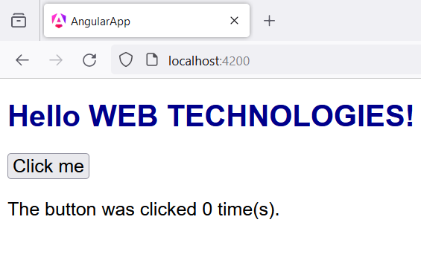
THE COUNTER COMPONENT
import { Component } from '@angular/core'; @Component({ selector: 'app-counter',
standalone: true, template: ` <button>Click me</button> <p>The button was clicked {{counter}} time(s).</p> `, styles: `p, button { font-size: 1.25em; font-family: sans-serif; } `
}) export class CounterComponent { counter: number = 0; }

Slide 18
HANDLING EVENTS
In Angular, events are bound to handlers using the parentheses syntax
For example, to assign an handler to the click event on a button, we can write in the template
<button (click)="increment()">Click me</button>
Where increment() is, for example, a method of the component

Slide 19
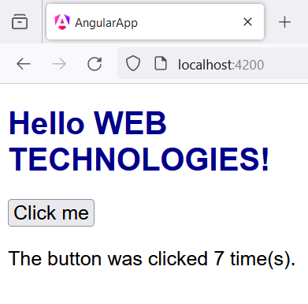
THE COUNTER COMPONENT
import { Component } from '@angular/core'; @Component({ selector: 'app-counter', standalone: true, template: ` <button (click)="increment()">Click me</button> <p>The button was clicked {{counter}} time(s).</p>
`, styles: 'p, button { font-size: 1.25em; font-family: sans-serif; }' }) export class CounterComponent { counter: number = 0; increment() { this.counter = this.counter + 1; } }

Slide 20
STANDALONE COMPONENTS
Standalone components set «standalone: true» in their metadata
These components can directly import other components, directives and pipes used in their templates
Older Angular code (before version 14) used a different mechanism for importing and using other components, called NgModule
In the Web Technologies course, we will only use standalone components

Slide 21
ANGULAR TEMPLATES: CONTROL FLOW
We’ve seen that Control flow constructs are very useful in templates
Often we need to conditionally render some part of the template, or to iterate over multiple elements and render the same portion of template over and over
Angular templates support these scenarios with the familiar
@if/@else and @for template syntax
Before Angular 17, ngIf and ngFor directives were used

Slide 22
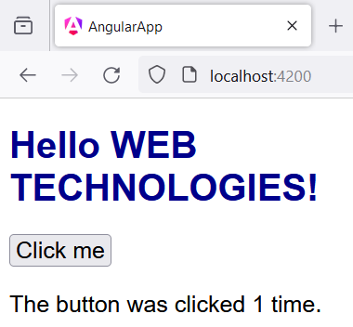
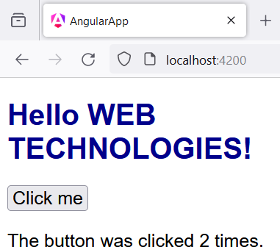
ANGULAR TEMPLATES: @IF/@ELSE
// template for the Counter component
<button (click)="increment()">Click me</button>
<p>
The button was clicked {{counter}} @if(counter===1){time} @else{times}.
</p>

Slide 23
ANGULAR TEMPLATES: @FOR
Let’s introduce a new feature to our Counter: it will keep track of the
times the button was clicked
// template for the Counter component
<button (click)="increment()"> Click me
</button>
<p>
The button was clicked {{counter}} @if(counter==1){time} @else{times}.
</p>
<ul>
@for(ts of clickTimestamps; track ts){
<li>{{ts}}</li>
} @empty {
<li>Button has never been clicked!</li>
}
</ul>
export class CounterComponent { counter: number = 0; clickTimestamps: Date[] = []
increment() {
this.counter = this.counter + 1; this.clickTimestamps.push(new Date());
}
}

Slide 24
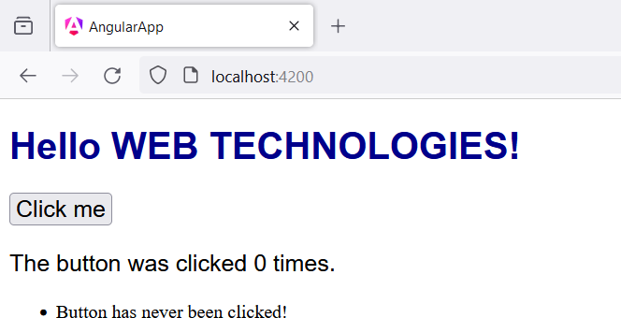
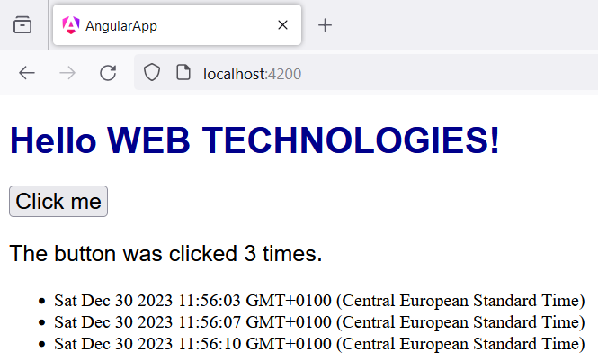
ANGULAR TEMPLATES: @FOR
Let’s introduce a new feature to our Counter: it will keep track of the times the button was clicked

Slide 25
COMPONENT COMMUNICATION
Sometimes, components need to share data with other components
This can happen when a parent component passes information to child components (e.g.: to configure their behaviour, or to pass data to visualize)
Or when a child component needs to communicate to its parent that some event has occurred
These communication patterns can be implemented in Angular using the @Input() and @Output() decorators

Slide 26
ANGULAR: @INPUT() DECORATOR
In the child component, properties that may be passed by the parent are decorated using @Input(). There might be a default value, used when the parent does not pass any specific value.
In our example, suppose that the text inside the button can be customized by the parent component
import {Component,Input} from '@angular/core';
export class CounterComponent {
@Input() buttonText = "Click me";
<button (click)="increment()">
{{buttonText}}
</button>
<p>
The button was clicked {{counter}} @if(counter==1){time}@else{times}.
</p>
// rest of the template omitted
counter: number | = | 0;
clickTimestamps | : | Date[] | = []
increment() {
this.counter = this.counter + 1;
this.clickTimestamps.push(new Date());
}
}
26

Slide 27
ANGULAR: @INPUT() DECORATOR
The parent component can now pass data to the child component by setting a property on the HTML element
@Component({
selector: 'app-root', standalone: true,
imports: [CounterComponent], template: `
<h1>Hello {{name.toUpperCase()}}!</h1>
<app-counter buttonText="CLICK HERE"/>
`,
styleUrl: "./app.component.scss"
})
export class AppComponent {}
export class CounterComponent { @Input() buttonText = "Click me"; counter: number = 0; clickTimestamps : Date[] = [];
increment() {
this.counter = this.counter + 1;
this.clickTimestamps.push(new Date());
}
}
<button (click)="increment()">
{{buttonText}}
</button>
// rest of the Counter template omitted₂₇

Slide 28
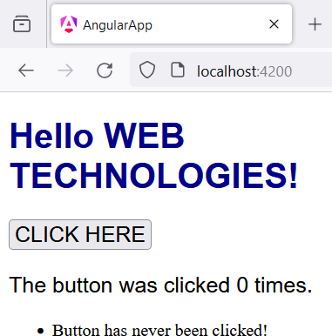
ANGULAR: @INPUT() DECORATOR
The parent component can now pass data to the child component by setting a property on the HTML element
If we removed buttonText="CLICK HERE" from <app-counter /> the button would display the default value («Click me»)
@Component({
selector: 'app-root', standalone: true, imports: [CounterComponent],
template: `
<h1>Hello {{name.toUpperCase()}}!</h1>
<app-counter buttonText="CLICK HERE"/>
`,
styleUrl: "./app.component.scss"
})
export class AppComponent {}

Slide 29
ANGULAR: @INPUT() DECORATOR RECAP
Child selector, inside Parent template
Source: Value from
parent
<app-counter buttonText="CLICK HERE"/>
Target: @Input() property from child

Slide 30
PARENT TO CHILD COMMUNICATION
This communication pattern is widely-used in front-end frameworks
In other frameworks (e.g.: React, Vue), this mechanism is implemented using Props.

Slide 31
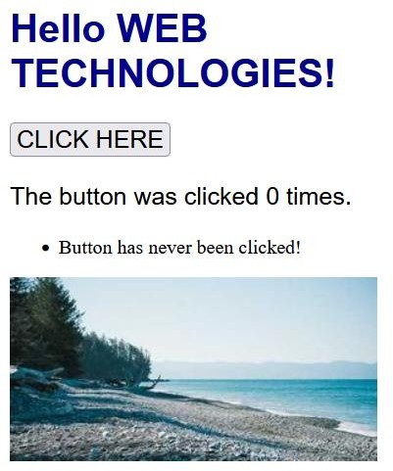
ANGULAR: PROPERTY BINDING
Angular allows to dynamically set values for attributes of HTML elements and components in templates, binding these values to properties of the current component
The name of the attribute to bind is specified between square brackets «[]», and the value is the name of the property to bind
<h1>Hello {{name.toUpperCase()}}!</h1>
<app-counter [buttonText]="btnMsg"/>
<img [src]="imageUrl"/>
export class AppComponent { name = 'Web Technologies'; btnMsg = "CLICK HERE";
imageUrl = "https://picsum.photos/300/150"
}
31

Slide 32
PROPERTY BINDING VS INTERPOLATION
You might wonder if there’s any difference between using property binding and template interpolation
<img [src]="imageUrl"/>
<img src={{imageUrl}}/>
In the above example, the outcome is the same
But that’s not always the case!
Template interpolation evaluates the provided expression and
converts the result to a string.
To pass an object or an array as an element property, you need to use property binding!

Slide 33
ANGULAR: @OUTPUT DECORATOR
To create a communication channel between a child and its parent, you can use the @Output decorator on a class property, and assign it a value of type EventEmitter
To send an event on the channel, the child component invokes the
emit() method on the @Output property

Slide 34
ANGULAR: @OUTPUT DECORATOR
export class CounterComponent {
@Input() buttonText = "Click me";
@Output() counterClickedTenTimes = new EventEmitter<number>(); counter: number = 0;
clickTimestamps : Date[] = []
increment() {
this.counter++; this.clickTimestamps.push(new Date()); if(this.counter%10 === 0)
this.counterClickedTenTimes.emit(this.counter);
}
}

Slide 35
ANGULAR: @OUTPUT DECORATOR
The parent component can now react to events on the communication channel by defining an event handler, as usual
<h1>Hello {{name.toUpperCase()}}!</h1>
<app-counter [buttonText]="btnMsg" (counterClickedTenTimes)=addClicks($event) />
<ul>@for(click of clicksList; track click){
<li>Button was clicked on {{click}} times.</li>
}</ul>
export class AppComponent {
name = 'Web Technologies'; btnMsg = "CLICK HERE"; clicksList : number[] = [];
addClicks(nClicks: number){ this.clicksList.push(nClicks)
}
}

Slide 36
ANGULAR: @OUTPUT() DECORATOR RECAP
Child selector, inside Parent template
Event Handler
(on the parent component)
<app-counter (counterClickedTenTimes)="addClicks($event)"/>
Event: @Output()
property from child

Slide 37
ANGULAR: ROUTING
Single Page Applications need to deal with client-side routing
Angular includes a Router to support devs in this task
The Router enables navigation between different views
It does so by interpreting the URL as an instruction to change the view
Angular apps created using the ng new command already have Routing configured and ready-to go
We’ll go over the steps to configure Routing in the next slides

Slide 38
ANGULAR ROUTER SETUP: BOOTSTRAP
In ./src/main.ts, the entry point of the Angular app, we take care of loading the root component (AppComponent)
In doing so, we provide a configuration object, defined in
./app/app.config.ts
The app.config object specifies that the application uses Routing
import | { | bootstrapApplication } from '@angular/platform-browser';
import | { | appConfig } from './app/app.config';
import | { | AppComponent } from './app/app.component';
bootstrapApplication(AppComponent, appConfig)
.catch((err) => console.error(err));

Slide 39
ANGULAR ROUTER SETUP: APP.CONFIG
The ./src/app.config.ts exports an appConfig object of type
ApplicationConfig
The provideRouter() function takes as input a description of the application routes of type Routes, defined in ./src/app.routes.ts, and sets up the necessary providers for the Router module to work
import | { | ApplicationConfig } from '@angular/core';
import | { | provideRouter } from '@angular/router';
import | { | routes } from './app.routes';
export const appConfig: ApplicationConfig = {
providers: [provideRouter(routes)]
};

Slide 40
ANGULAR ROUTER SETUP: APP.ROUTES
The Routes object is defined in ./src/app.routes.ts
import { Routes } from '@angular/router';
import { CounterPageComponent } from './counter-page/counter-page.component'; import { HomePageComponent } from './home-page/home-page.component';
export const routes: Routes = [
{
path: "",
title: "Home Page", component: HomePageComponent
}, {
path: "counter",
title: "Counter",
component: CounterPageComponent
}
];
//Routes is a Route[]
//Each Route has many properties:
//- path is the URL associated with the Route
//- title is the title of the HTML page
//- component is the component associated with
// the Route

Slide 41
ANGULAR ROUTER SETUP: ROUTER-OUTLET
With all the setup in place, we can use the RouterOutlet component in our templates
The RouterOutlet component analyzes the current URL, and renders the Component associated with the matching path
The template for the root component may look similar to the one shown below
<nav>
<a href="/">Home</a> | <a href="/counter">Counter</a>
</nav>
<router-outlet></router-outlet>

Slide 42
ANGULAR ROUTER SETUP: ROUTER-OUTLET
import | { | Component } from '@angular/core';
import | { | CommonModule } from '@angular/common';
import | { | RouterOutlet } from '@angular/router';
@Component({
selector: 'app-root',
standalone: true,
imports: [CommonModule, RouterOutlet], template: `
<nav>
<a href="/">Home</a> | <a href="/counter">Counter</a>
</nav>
<router-outlet></router-outlet>
`,
styleUrl: "./app.component.scss"
})
export class AppComponent {}

Slide 43
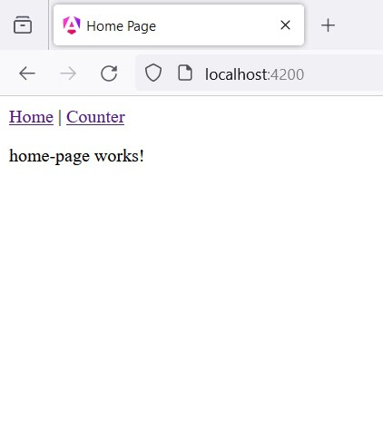
ANGULAR ROUTER: LINKS
If we use traditional links in our templates, with an href attribute, we cause the browser to perform a new HTTP request and re-load the app
The Router then analyzes the URL, and loads the appropriate component in place of the <router-outlet/>
This is not very sleek, and defeats the very purpose of a Single Page App

Slide 44
ANGULAR ROUTER: LINKS
To properly navigate between views in our Angular SPAs, we need to use the RouterLink directive on elements that trigger navigation
import | { | Component } from '@angular/core';
import | { | CommonModule } from '@angular/common';
import | { | RouterLink, RouterOutlet } from '@angular/router';
@Component({
selector: 'app-root', standalone: true,
imports: [CommonModule, RouterOutlet, RouterLink], template: `
<nav><a routerLink="/">Home</a> | <a routerLink="/counter">Counter</a></nav>
<router-outlet></router-outlet>
`,
})
export class AppComponent {}

Slide 45

ANGULAR ROUTER: LINKS
When we use RouterLink, we can trigger the Router and load different views without reloading the page
This is how SPAs should handle routing!
Notice that, if a user manually inserts the localhost:4200/counter URL, they would trigger a new page load, and the Router would still properly render the Counter component.

Slide 46
ANGULAR ROUTER: ROUTERLINKACTIVE
Sometimes, we want to style the router links that are currently active differently, to remind the users which page they are on
The RouterLinkActive directive allows us to specify a list of CSS classes that should be applied to RouterLinks that correspond to the Route the app is currently on
These directives can be used in a template as follows
<nav>
<a routerLink="/" routerLinkActive="active" [routerLinkActiveOptions]="{exact: true}">
Home
</a> |
<a routerLink="/counter" routerLinkActive="active">Counter</a>
</nav>
<router-outlet></router-outlet>

Slide 47
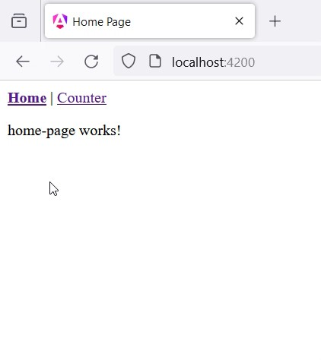
ANGULAR ROUTER: ACTIVE LINKS
With the template shown in the previous slide and a little bit of CSS (shown below), we can highlight active links in bold
nav .active {
font-weight: bold;
}

Slide 48
REFERENCES
Angular Docs
https://angular.dev/overview
Relevant parts: Introduction: Essentials; In-depth Guides: Components, Template Syntax, Routing; Developer Tools: Angular CLI

